Slide 1
Stratigraphy
7 HASS

Slide 2
Lesson Objectives
Learning Intentions
Success Criteria
Understand the concept of Stratigraphy and how it relates to Archaeology
demonstrate how time is recorded in layers
define and demonstrate stratigraphy
explain how stratigraphy can be destroyed through human intervention

Slide 3
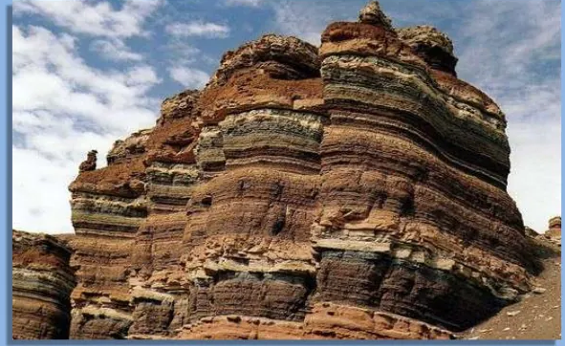
Stratigraphy
What is Stratigraphy?
How does it relate to Archaeology?
Stratigraphy is defined as the arrangement of materials in layers. As layers are deposited, the oldest is usually on the bottom and the youngest on top.
By examining the materials found in these layers and their relationships to each other, archaeologists can determine what artifacts are older or younger than others.

Slide 4
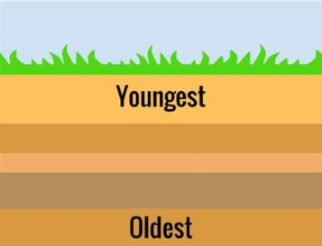
Law of superposition
The Law
This principle states that layers of rock are superimposed, or laid down one on top of another. The oldest rock strata will be on the bottom and the youngest at the top.

Slide 5


Two Instructions for this Lesson
Do NOT eat yours or other materials until instructed to do so.
Work at a reasonable volume and LISTEN

Slide 6

Equipment
3 slices of Bread
3 spoons of Jam
2 spoons of Peanut Butter
White Choc Chips
Milk Choc Chips
Sprinkles
Paper Plate
Napkin
Knife
Straw

Slide 7

Stage 1
Here we have a field located in Texas, Near a River
Lay down your first slice of bread

Slide 8
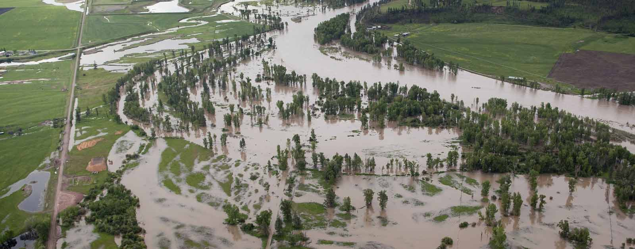
Stage 2
The river floods, covering the field.
Spread a layer of Peanut Butter

Slide 9
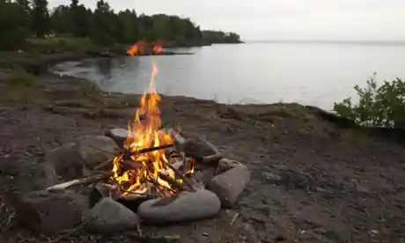
Stage 3
Shortly after the flood, a group of Archaic people camp in the area and build a fire. Their fire leaves behind charcoal and rocks that crack from the heat
Place your milk choc chips in a circle on top of the layer of peanut butter and fill the circle with sprinkles.

Slide 10
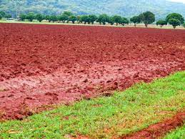
Stage 4
The Archaic people depart and through time, a layer of dirt form over the campsite.
Place down another piece of Bread.

Slide 11
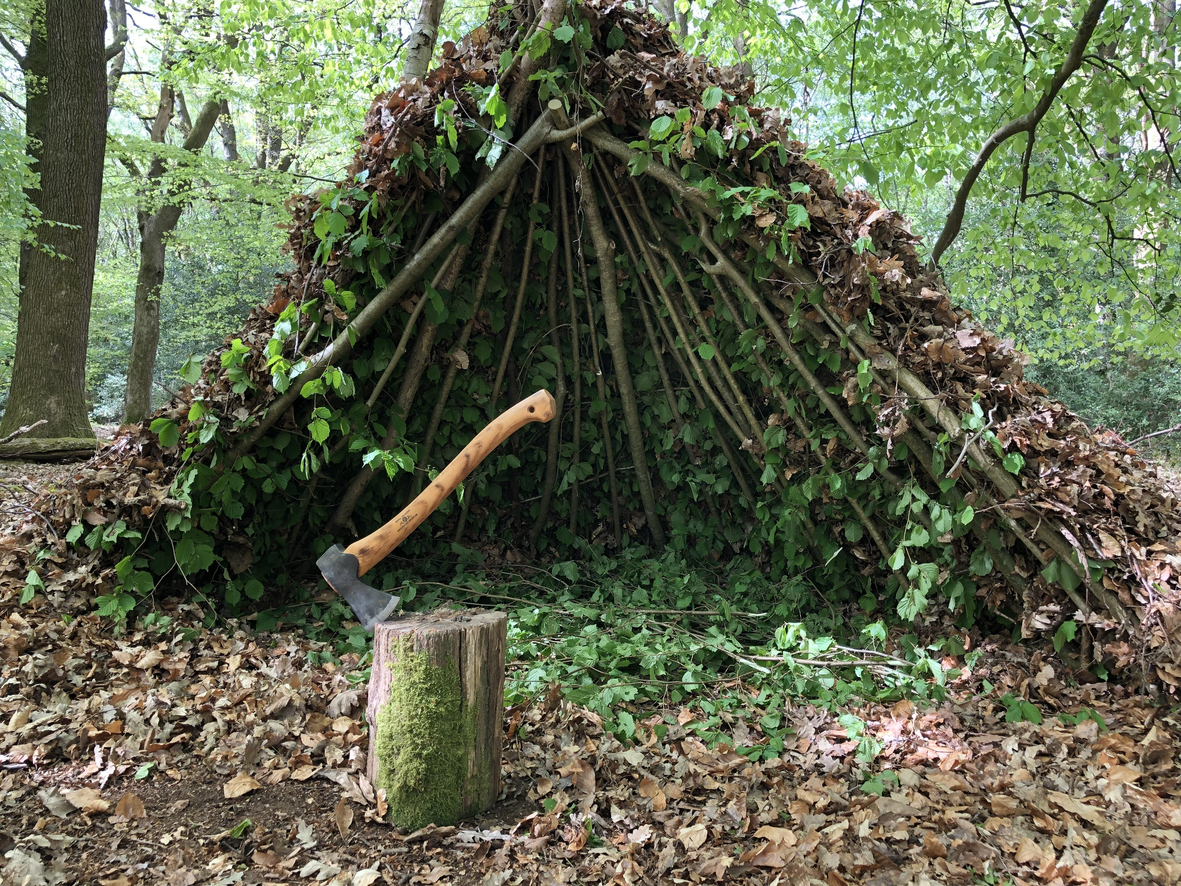
Stage 5
Eventually a Woodland group comes to the same field. These people build shelters.
Using your straw gently cut small indentations or holes in the last slice of bread. These represent the holes dug to hold posts for shelters

Slide 12
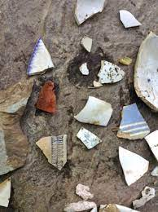
Stage 6
These Woodland people made a lot of pottery, but some of the pottery got broken.
Place some white chocolate chips in the holes in the bread.

Slide 13
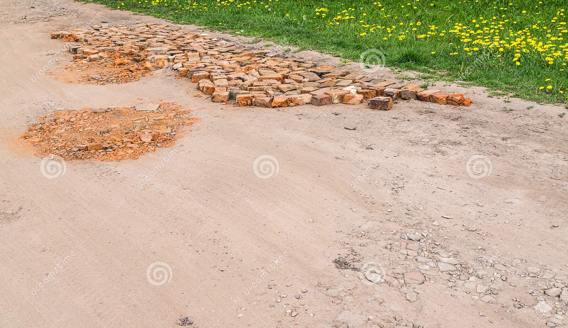
Stage 7
Spread on a layer of Jam.
The Jam may cause same redistribution of pottery, a situation that occurs on real sites)

Slide 14

Stage 8
Through time, other layers are laid down until the present and final layer of dirt covers the site.
Place on your final piece of bread.

Slide 15
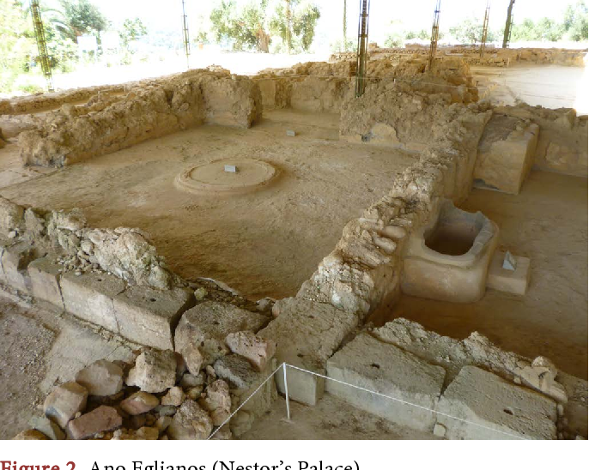
Stage 9
What is a habitation site?
Today, an archaeologist suspects this field was a prehistoric habitation site and conducts random core samples and surveys.
Push straws randomly through the sandwich. If you have found a sprinkle or a piece of chocolate then you have found a habitation site.

Slide 16
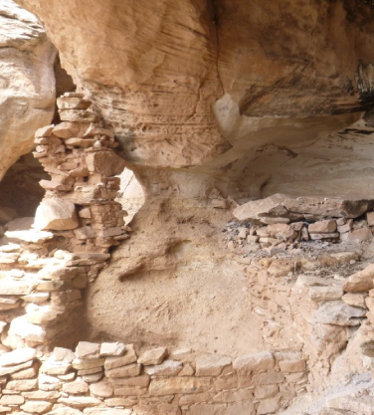
Habitation Site
A habitation site is a place where people have lived. Prehistoric habitation sites may be marked by postholes, cooking pits, middens (trash pits), or artifacts.

Slide 17
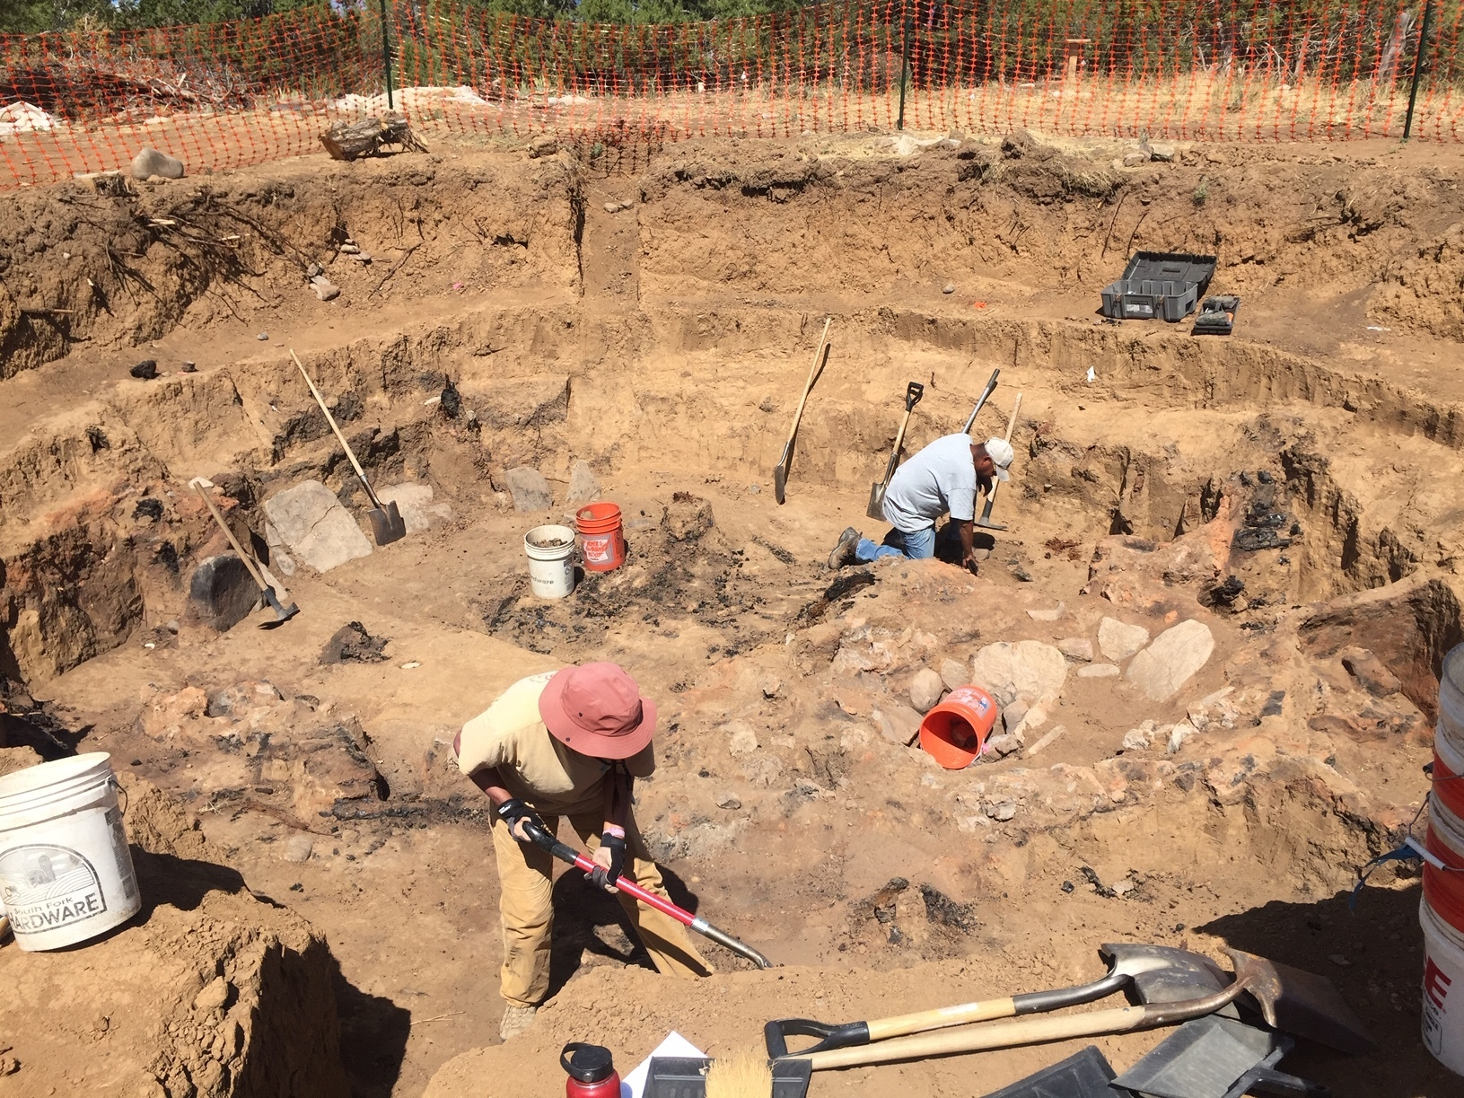
Stage 10
The archaeologist conducts a test excavation at the site.
cut a square into the sandwich and remove layers, one by one. If you find something, you have found the habitation site.

Slide 18
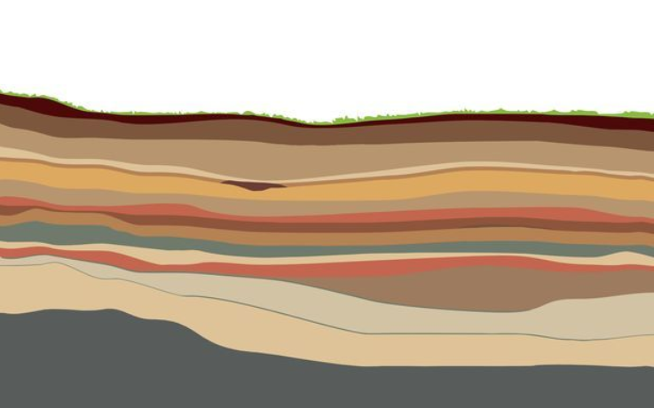
These layers are stratigraphy
What is the oldest layer?
Which habitation is older?

Slide 19
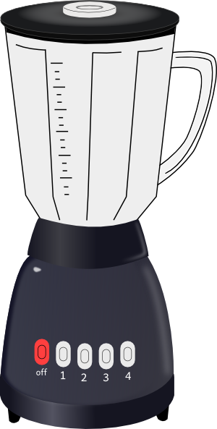
Blender
What happens if we blend our layers?

Slide 20
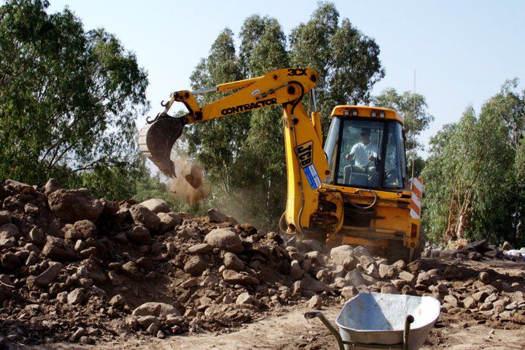
Disturbing Archaeological Sites.
This is what happens when we disturb a habitation site.
Plow, Loot or Bulldoze.

Slide 21
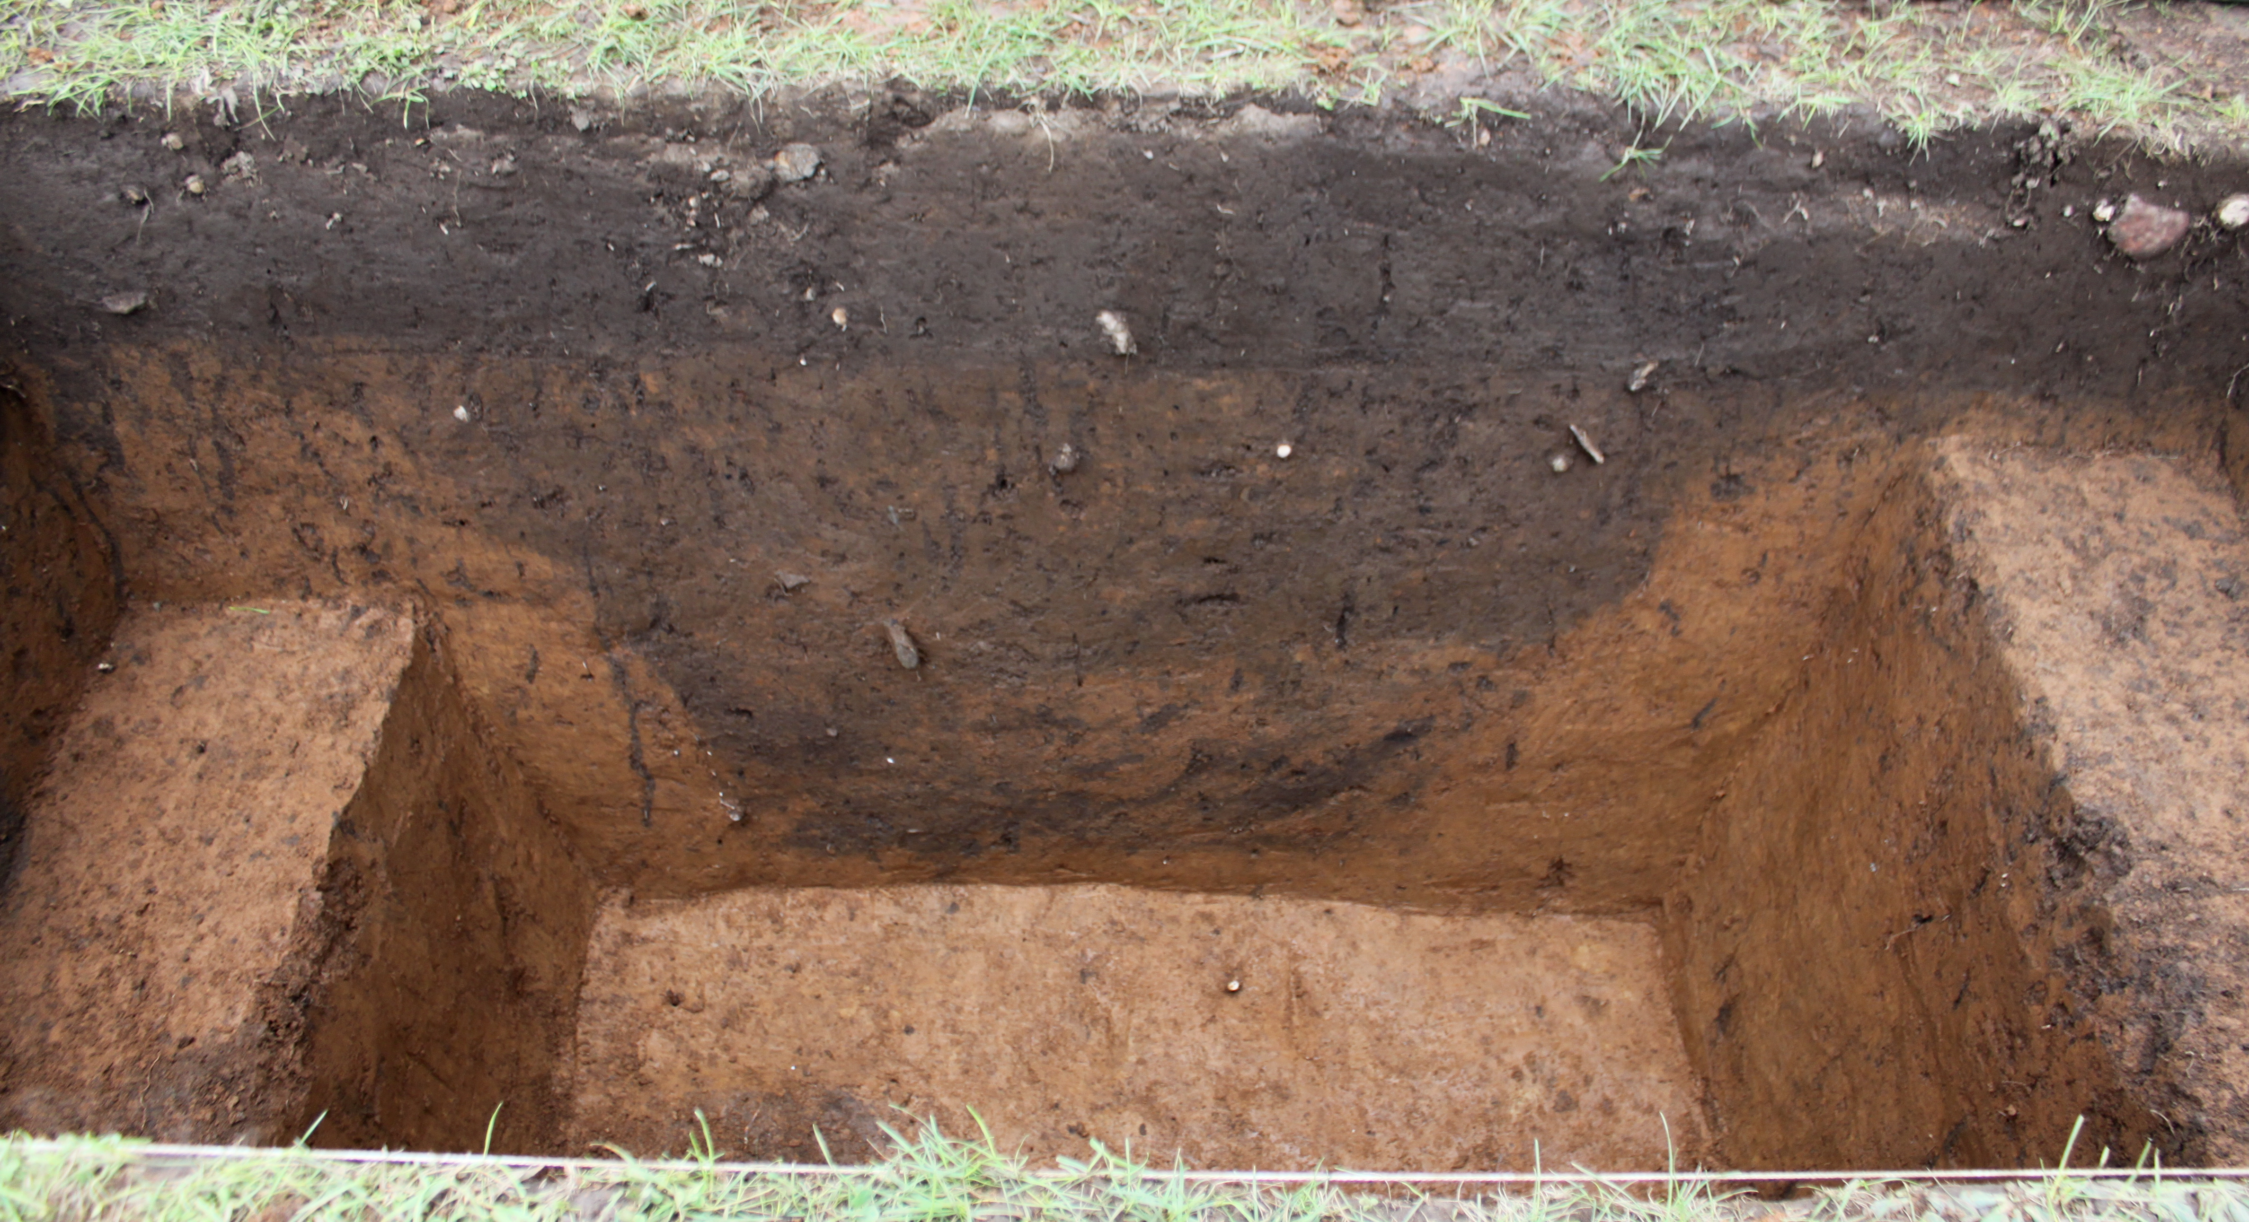
Full Excavations
To fully excavate a site we have to remove each layer one at a time.
Would you have your sandwich then?
Excavation is a destructive process.

Slide 22

You can now EAT your excavation site.

Slide 23

COOKIE EXCAVATION

